Slide 2
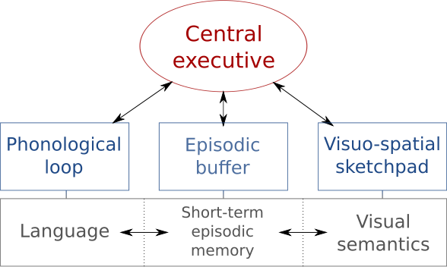
Cognition: Baddeley’s working memory model

Slide 3
Vision

Slide 4
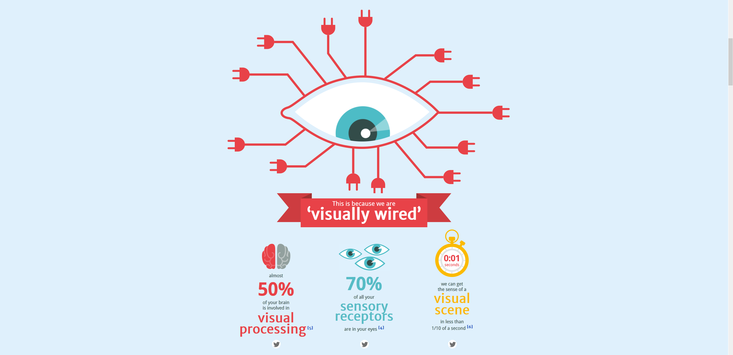
Notes:
https://neomam.com/interactive/13reasons/

Slide 5
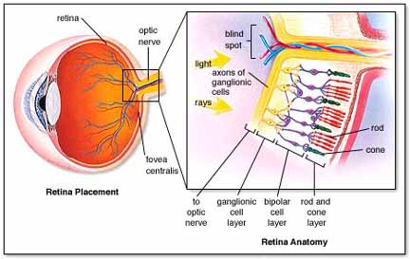
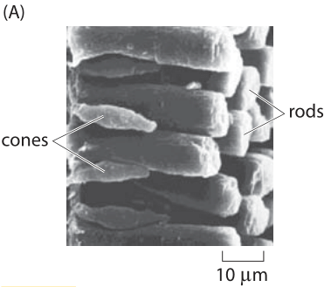
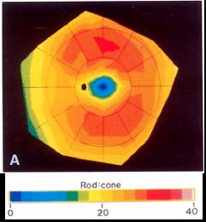
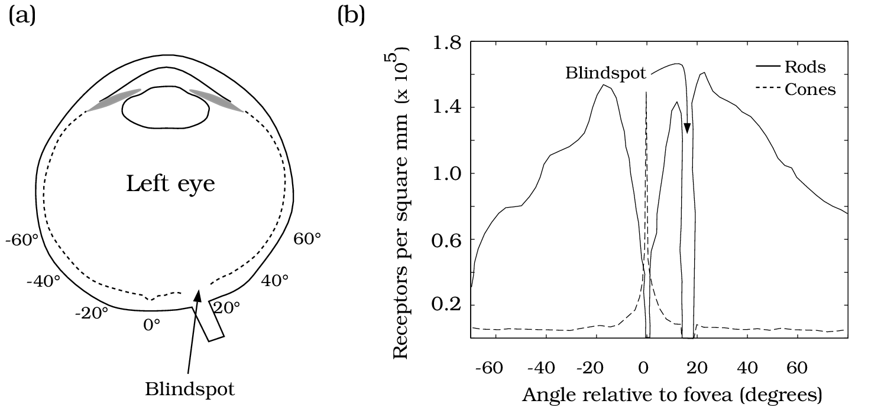
Notes:
http://www.rci.rutgers.edu/~uzwiak/AnatPhys/NPSpringLect4_files/image018.jpg
https://www.today.com/health/pain-floaters-5-eye-symptoms-you-should-never-ignore-t100301
http://www.carolguze.com/images/organsystems/Sensory/eye.jpg
http://book.bionumbers.org/how-big-is-a-photoreceptor/

Slide 6
Cones | Rods
Foveal Vision (High Acuity), Small | Peripheral Vision, Large
3 receptors (color vision) | 1 receptor (no color)
Low Light Sensitivity | High Light Sensitivity
Slow (Low ISO) | Fast (High ISO)
Parvocellular Pathway | Magnocellular Pathway
Ventral Visual Pathway (What) | Dorsal Visual Pathway (How)

Slide 7
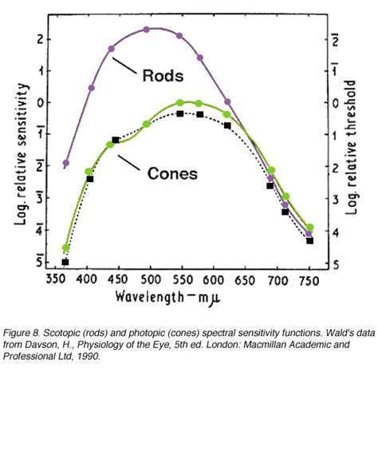
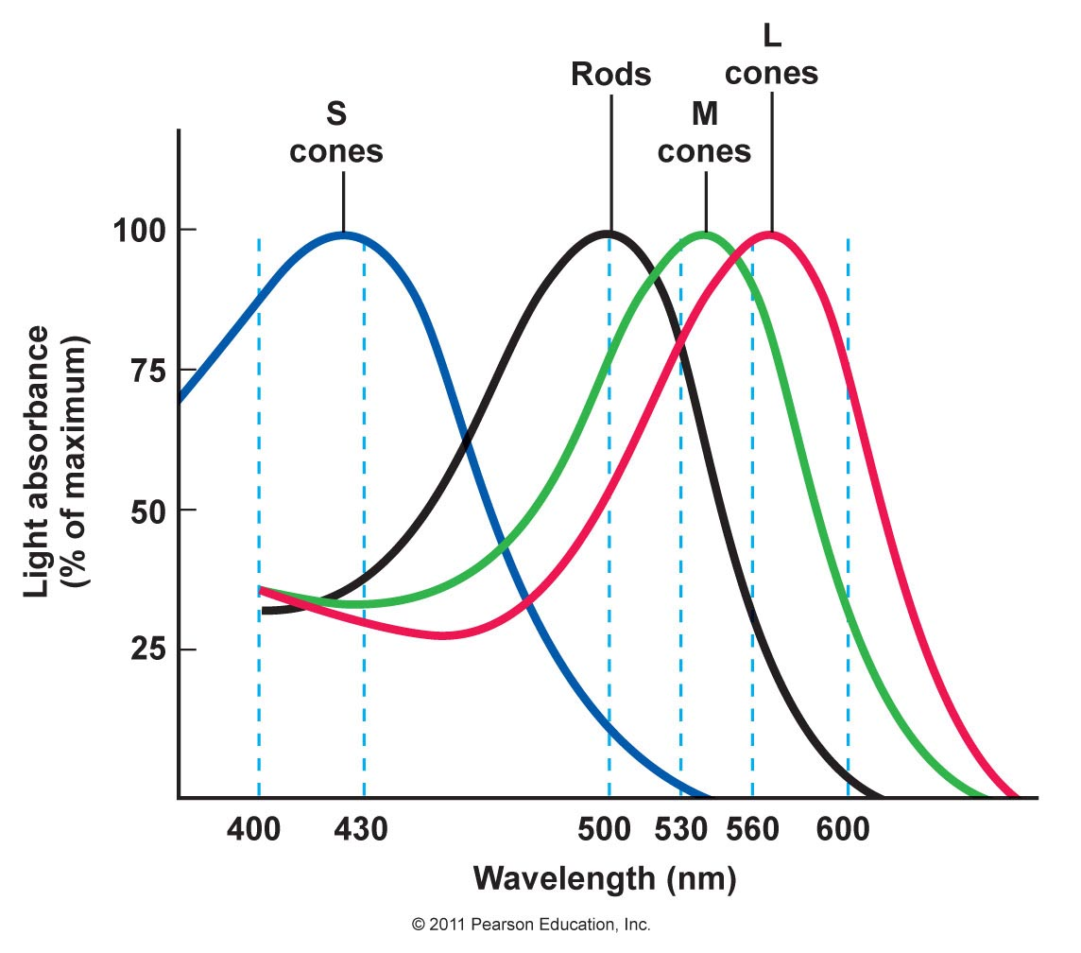
Notes:
http://retina.umh.es/Webvision/imageswv/KallDark8.jpg
http://droualb.faculty.mjc.edu/Course%20Materials/Physiology%20101/Chapter%20Notes/Fall%202011/chapter_10%20Fall%202011.htm

Slide 8
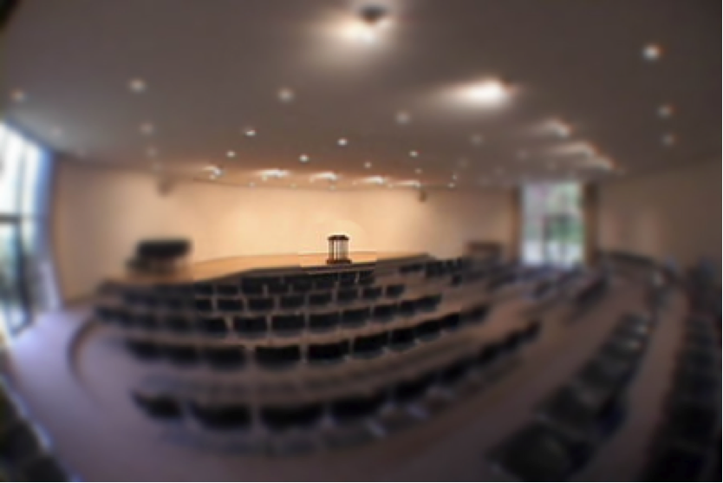
Foveal vs. Peripheral Vision
Foveal Vision: 4-8° Field of View: 205 ° Blind Spot: 5-6° hor. 7-8° ver.
Notes:
https://dslauretta.files.wordpress.com/2014/01/foveal-region.png

Slide 9
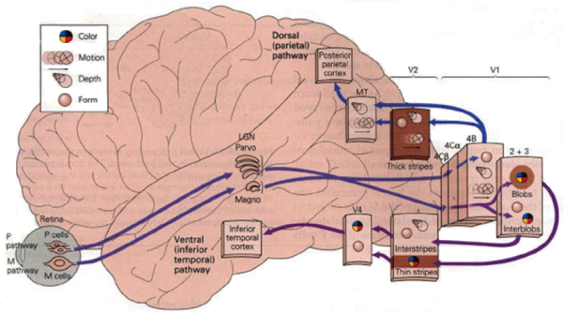

Slide 10
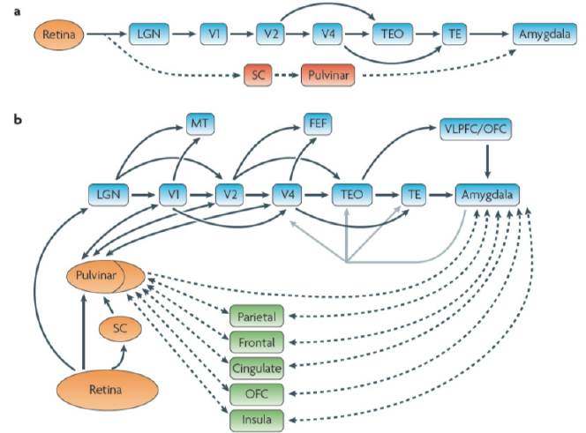

Slide 11
How does this work?

Slide 12
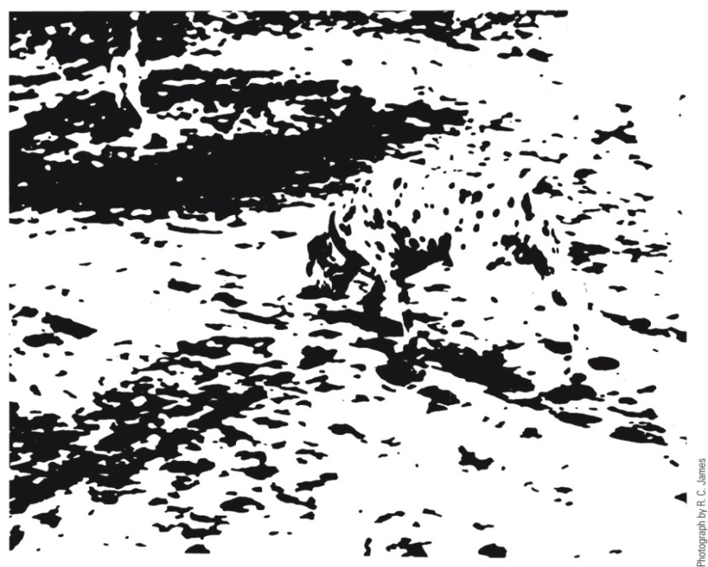
Gestalt Psychology
The whole differs from the sum of its parts

Slide 13
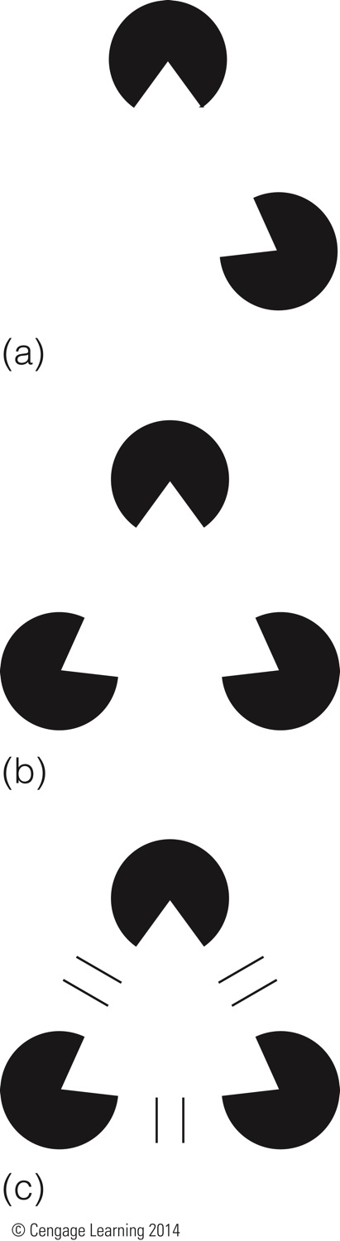
Illusory Contours

Slide 14
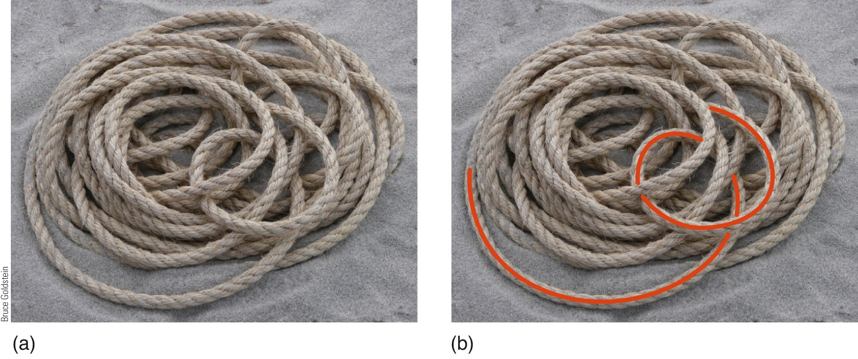
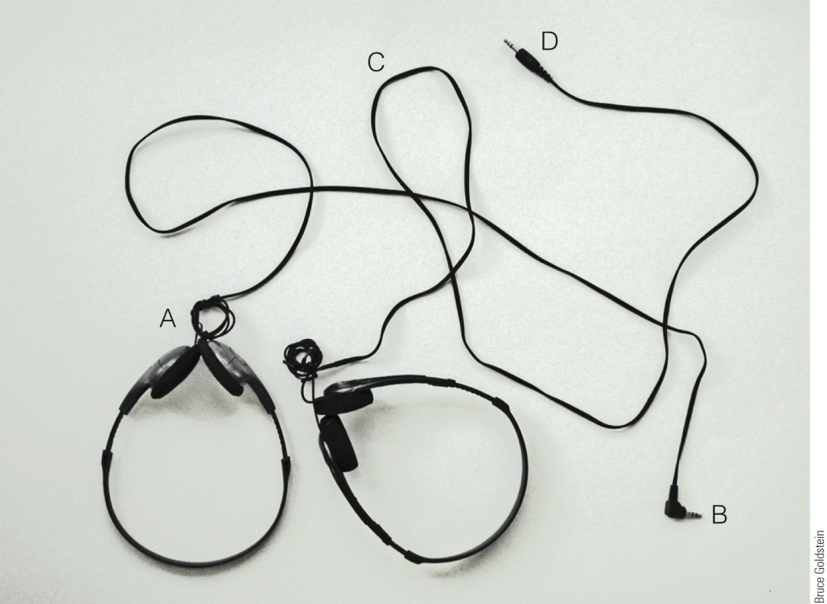
Good Continuation

Slide 15
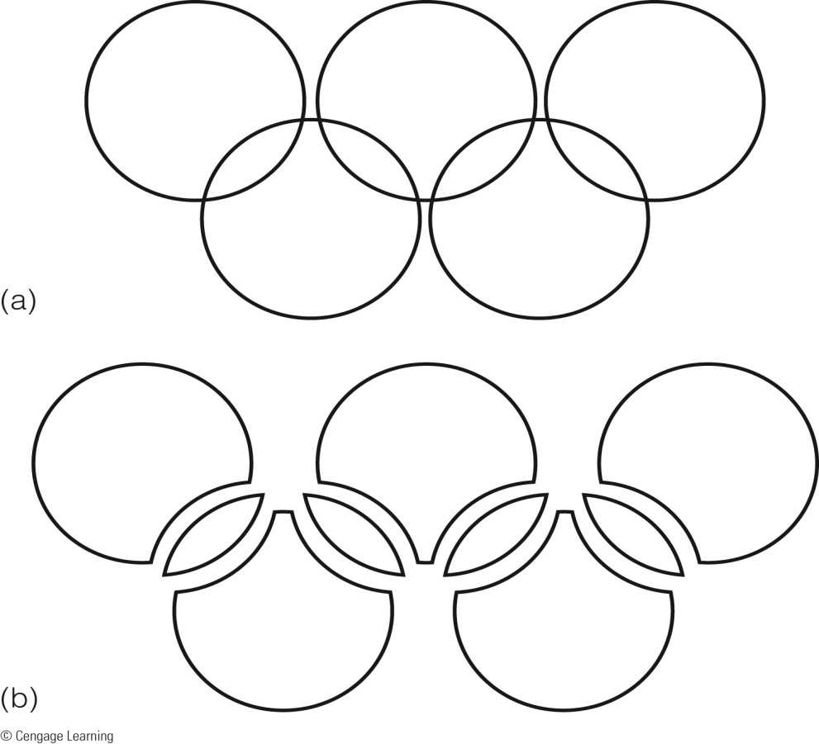
Pragnanz (Good Figure)

Slide 16
Pragnanz (Good Figure)

Slide 17
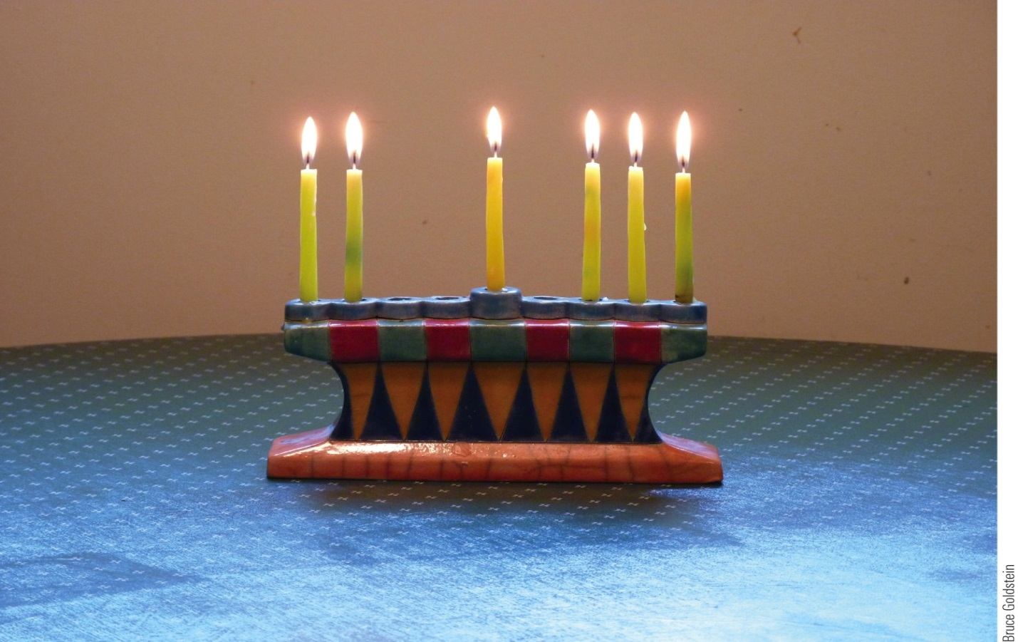
Gestalt Principles - Proximity

Slide 18
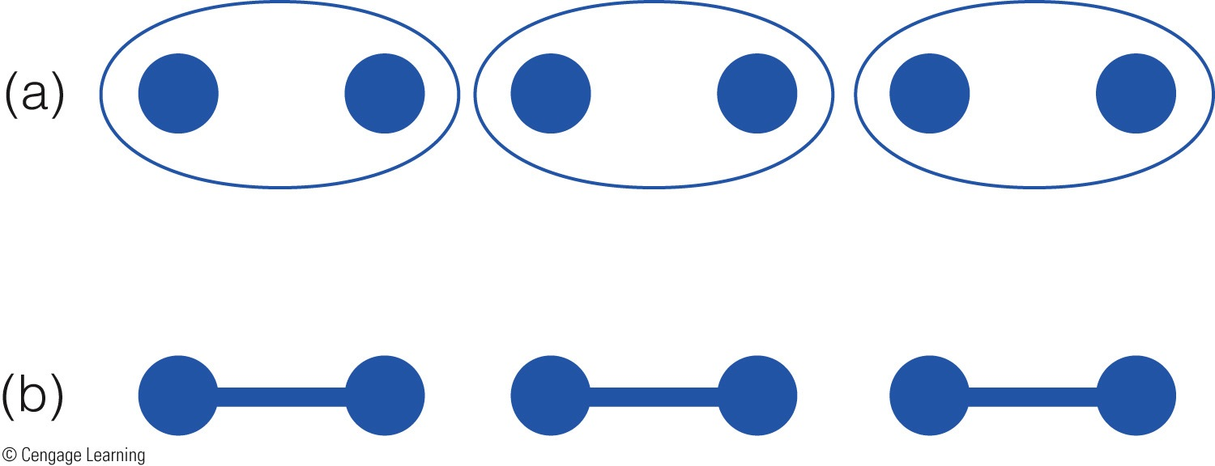
Gestalt Principles – Common Region

Slide 19
Gestalt Principles – Connectedness

Slide 20
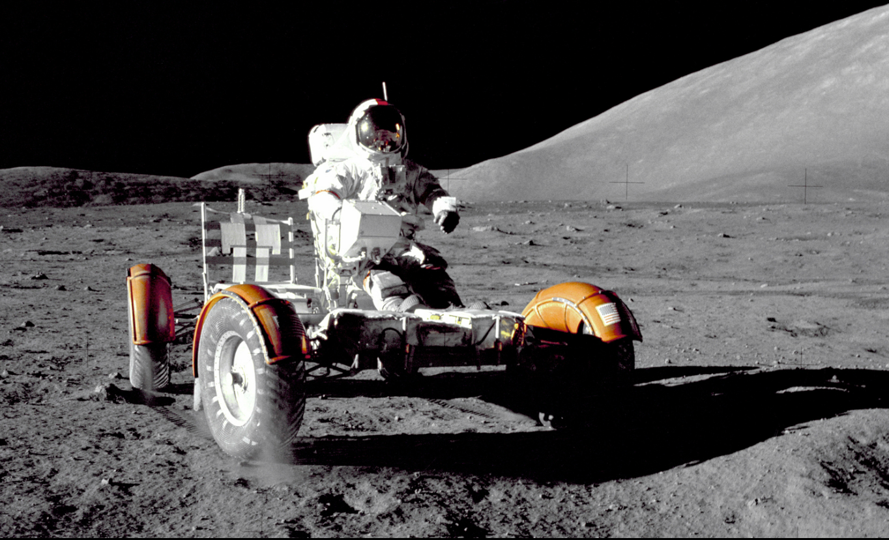

Slide 22


Slide 23
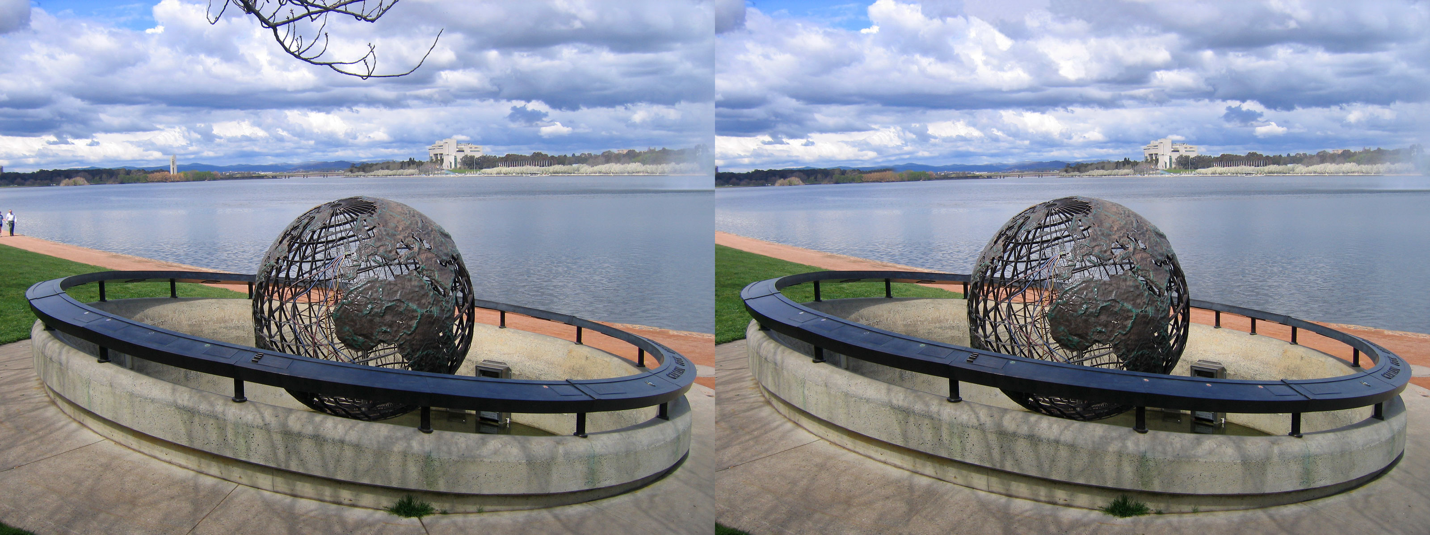

Slide 26
Change Blindness
Perceptual phenomenon that occurs when a change in a visual stimulus is introduced and the observer does not notice it
Demo at gocognitive.net (Dr. Steffen Werner, UI)

Slide 28
Summary
Human visual processing and cognition is complex with unique strengths and weaknesses
We don’t see the world as it is, but as influenced by our sensory abilities and top-down processing

Slide 29
Design is Theory Working Backwards
System
HRA
Design
Human Factors

Slide 30
Global (Holistic) Processing
Driven by preattentive processes

Slide 31
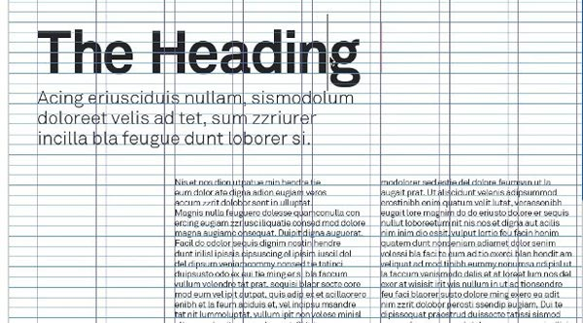
Typographic Grid

Slide 32
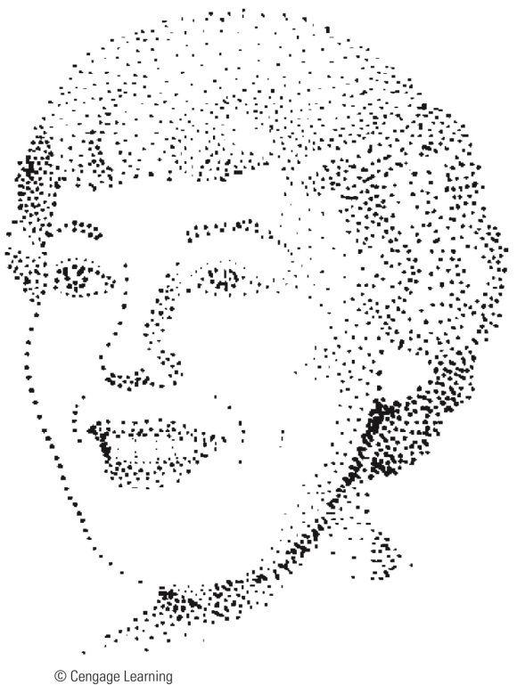
Global vs. Local Processing
T T T T
T
T
T T T T
T
T
T
T
F F F F
F
F
F F F F
F
F
F
F
Emergent Features

Slide 33
Global processing -> Reduced attentional demands if displays compatible with task

Slide 34
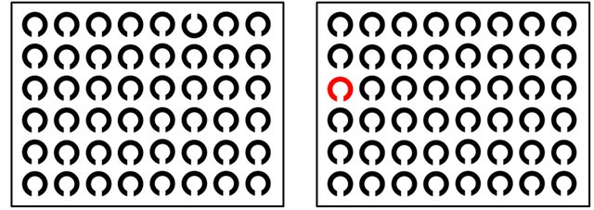
Salience
The state or quality by which it stands out from its neighbors
https://www.researchgate.net/publication/270221266_Top-Down_but_Not_Bottom-Up_Visual_Scanning_is_Affected_in_Hereditary_Pure_Cerebellar_Ataxia/figures?lo=1
Notes:
https://www.researchgate.net/publication/270221266_Top-Down_but_Not_Bottom-Up_Visual_Scanning_is_Affected_in_Hereditary_Pure_Cerebellar_Ataxia/figures?lo=1

Slide 35
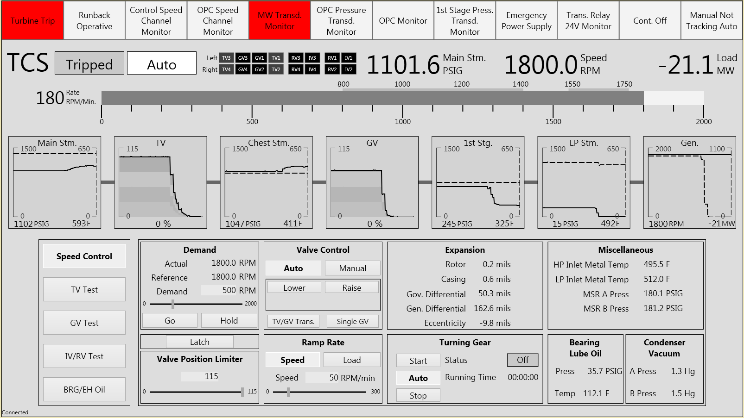

Slide 36
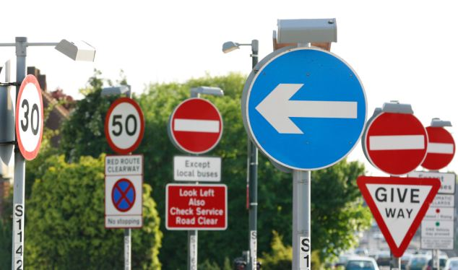

Slide 37
Object Displays
Capitalizing on the parallel processing of object features
Volume
Rate
Woods, Wise, and Hanes, 1981
Cole, 1986

Slide 38
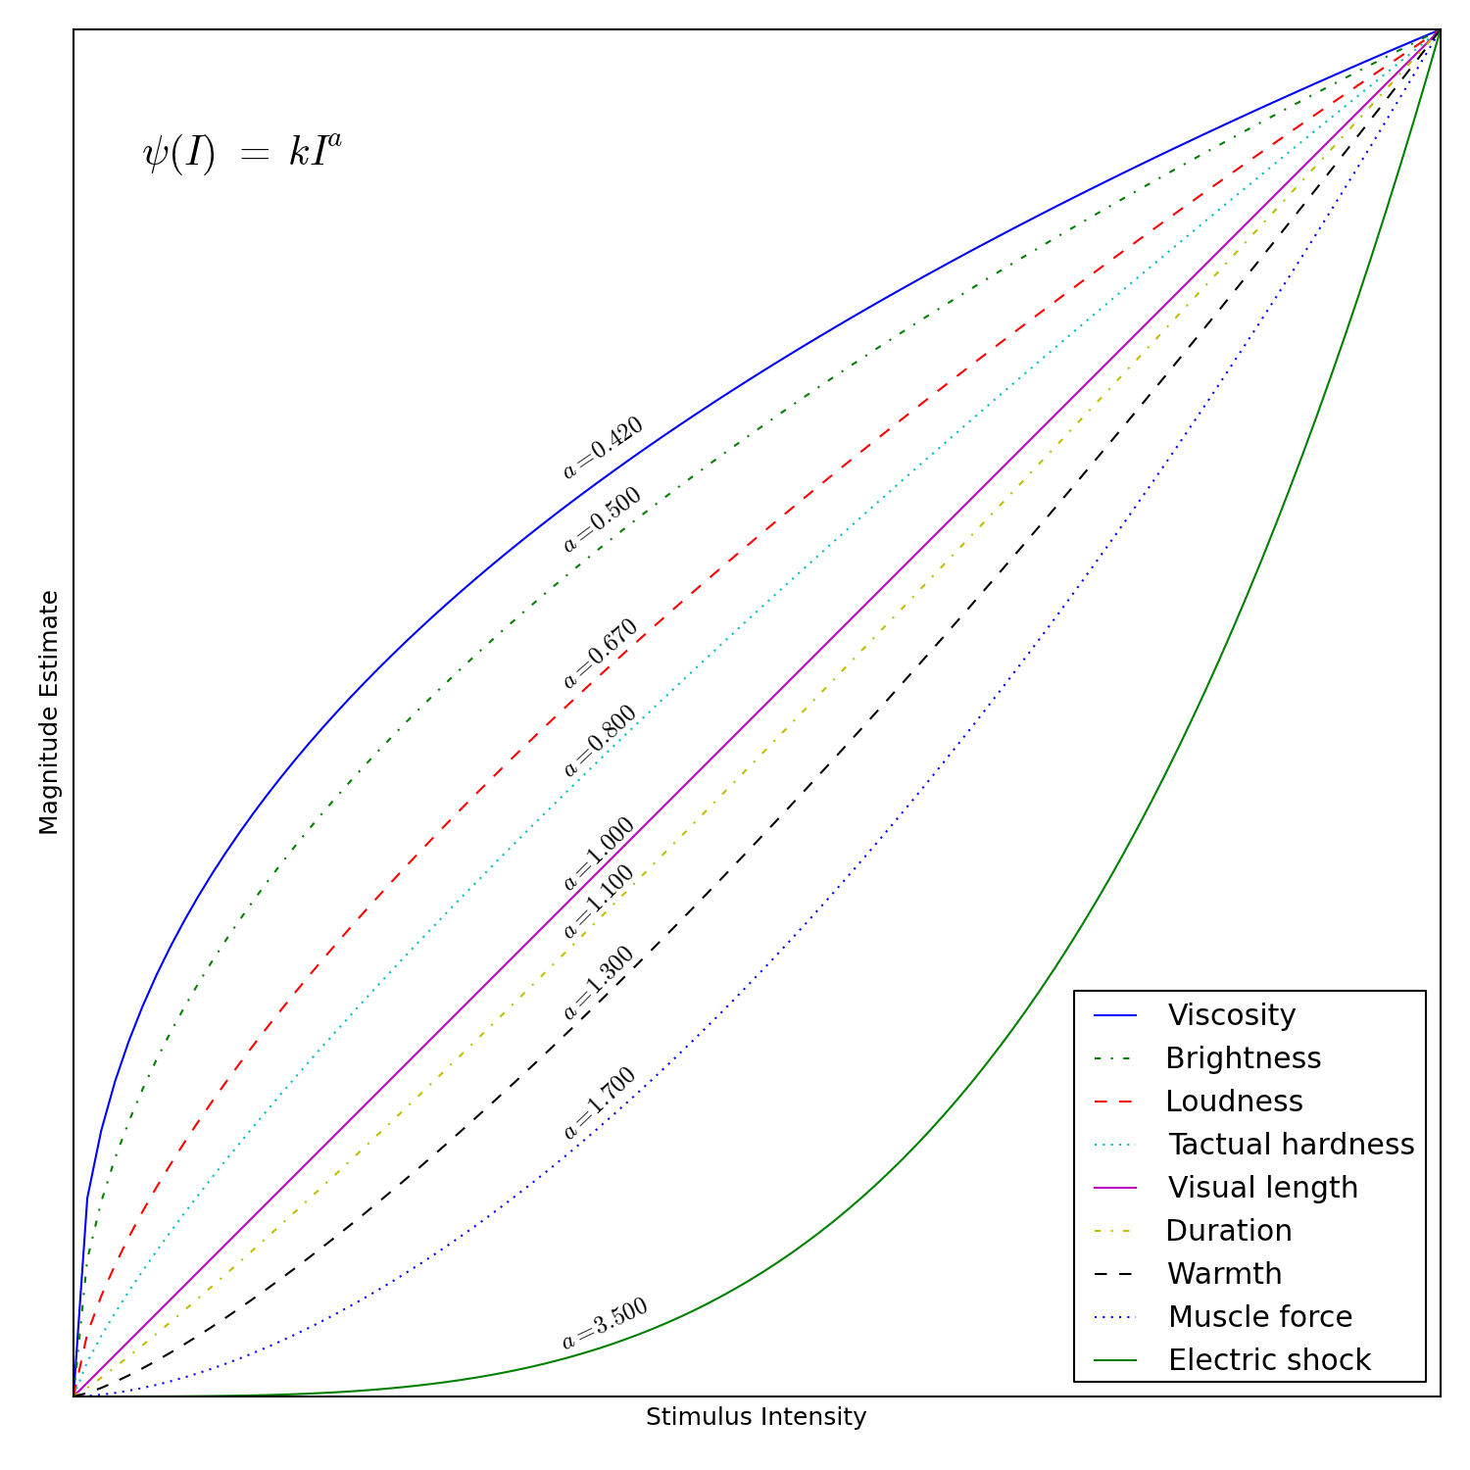
Steven’s Power Law
Describes relationship between a physical stimulus and how it is perceived as a power function

Slide 39
Human Factors General Principles

Slide 40
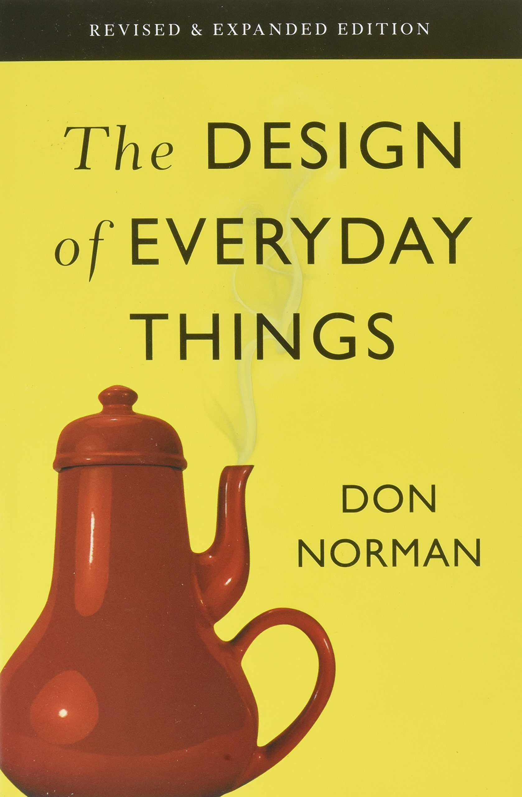
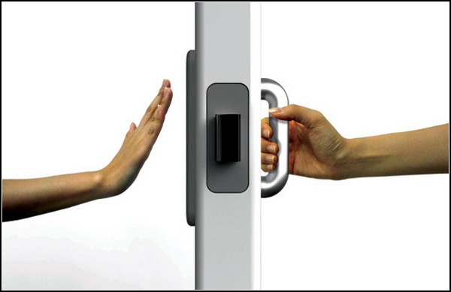
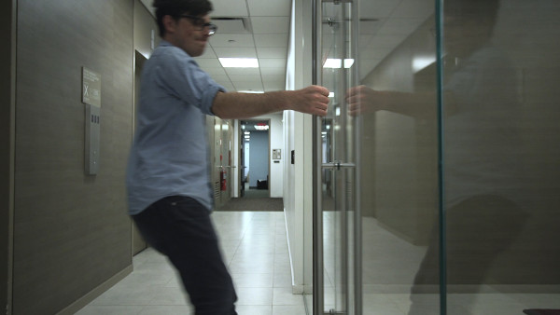
Affordances

Slide 41
Extends to Digital Interfaces
Is the interface intuitive?
Can you discern:
what is a control and what is not?
what is a display and what is not?
what information is static?
what is hyperlinks?

Slide 42
(Nielsen,) Jakob’s Law
Users spend most of their time on other sites. This means that users prefer your site to work the same way as all the other sites they already know.

Slide 43
Provide Feedback
Provide feedback so the user knows the system has received the command
Button depressed
Spinning wheels
Sound
Secondary Indications

Slide 44
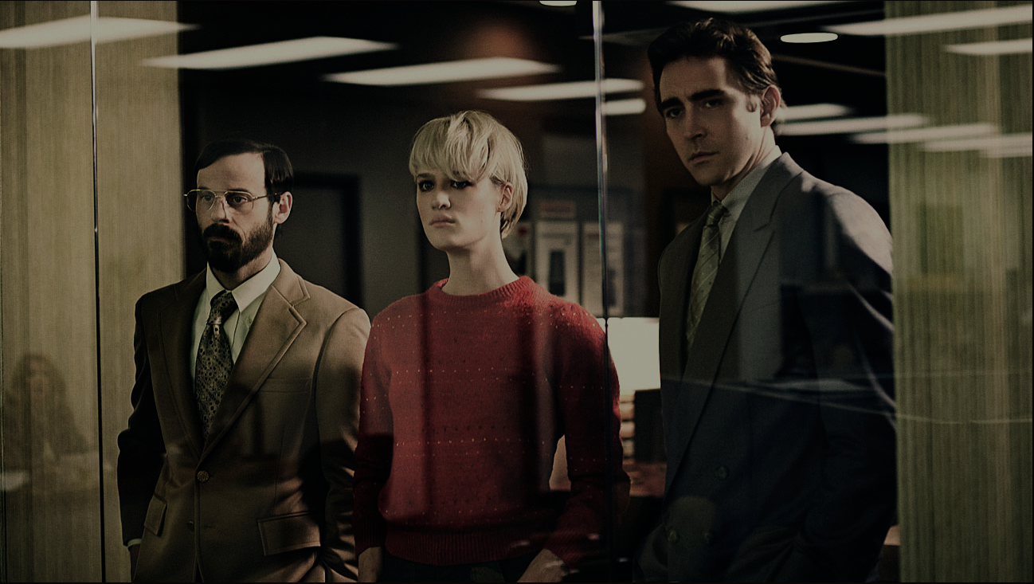
Doherty Threshold
In 1982 Walter J. Doherty and Ahrvind J. Thadani published, in the IBM Systems Journal, a research paper that set the requirement for computer response time to be 400 milliseconds, not 2,000 (2 seconds) which had been the previous standard. When a human being’s command was executed and returned an answer In under 400 milliseconds, it was deemed to exceed the Doherty threshold, and use of such applications were deemed to be “addicting” to users.
lawsofux.com/doherty-threshold.html

Slide 45
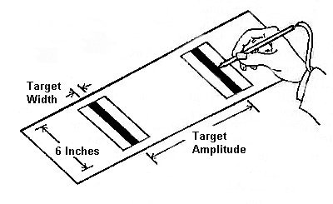



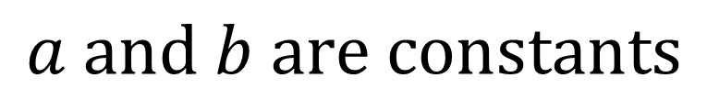
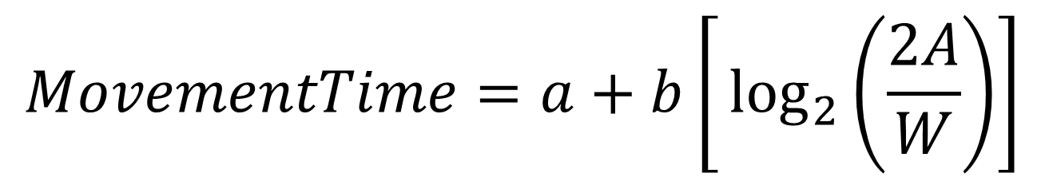
Fitts’ Law (1954)
$$ID (Index of Difficulty)$$
$$MovementTime=a+b\left[⁡\log_{2}\left(\frac{2A}{W}\right)\right]$$
$$a and b are constants$$
$$A is Movement Amplitude$$
$$W is Target Width$$

Slide 46
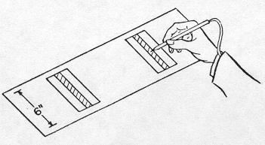
4 units
16 units

Slide 47
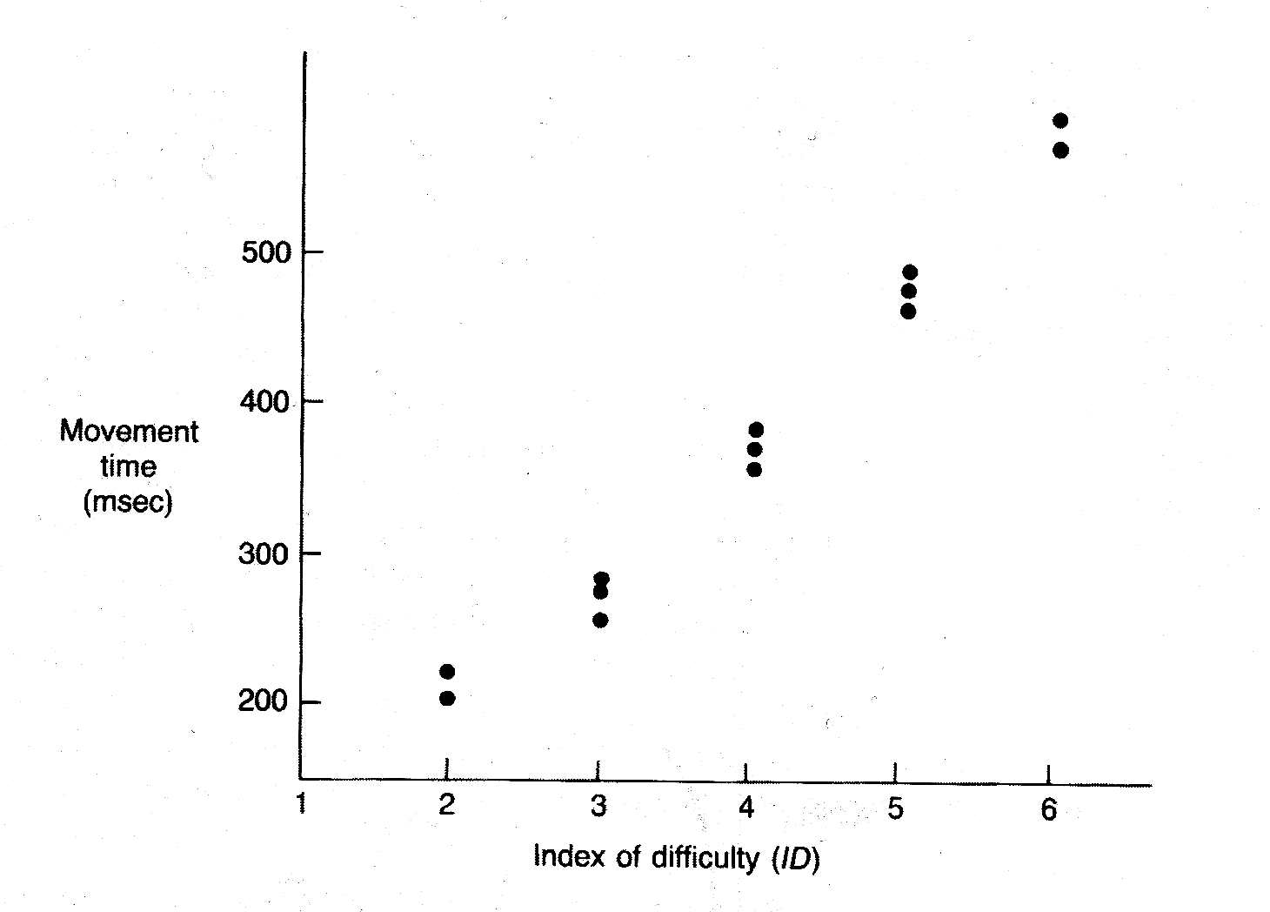
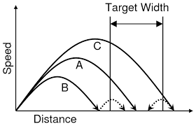

Slide 48

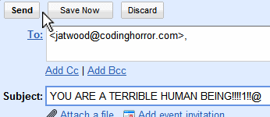

2018 Gmail
2010 Gmail
Apple Watch Apps

Slide 49
Steven’s Power Law

Slide 50
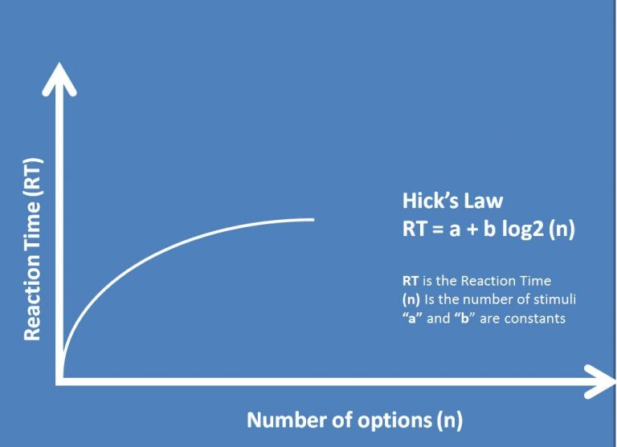
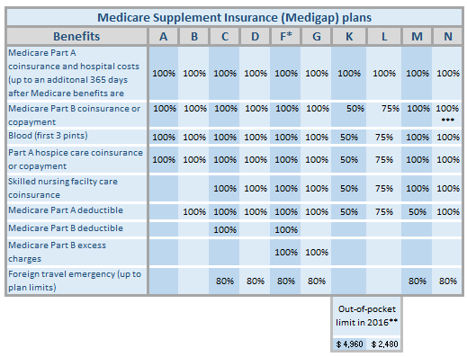
Hick’s Law

Slide 51
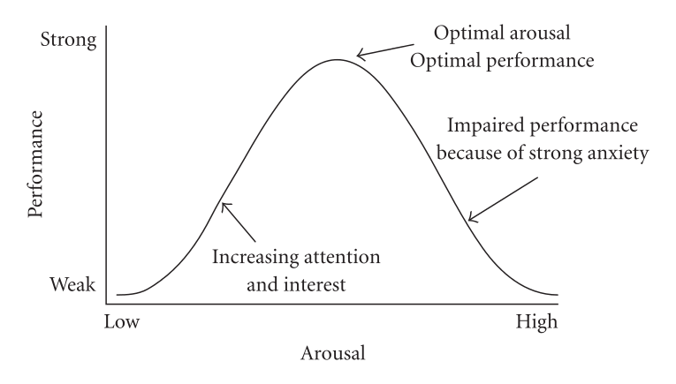

Yerkes–Dodson law
Notes:
https://en.wikipedia.org/wiki/Yerkes%E2%80%93Dodson_law#/media/File:HebbianYerkesDodson.svg
https://www.michiganautolaw.com/blog/2014/12/27/droopy-eyelid-detector/
https://duckduckgo.com/?q=overworked&t=ffsb&iar=images&iax=images&ia=images&iai=https%3A%2F%2Fc8.alamy.com%2Fcomp%2FABC687%2Foffice-environment-frustrated-overworked-office-worker-at-her-desk-ABC687.jpg

Slide 52
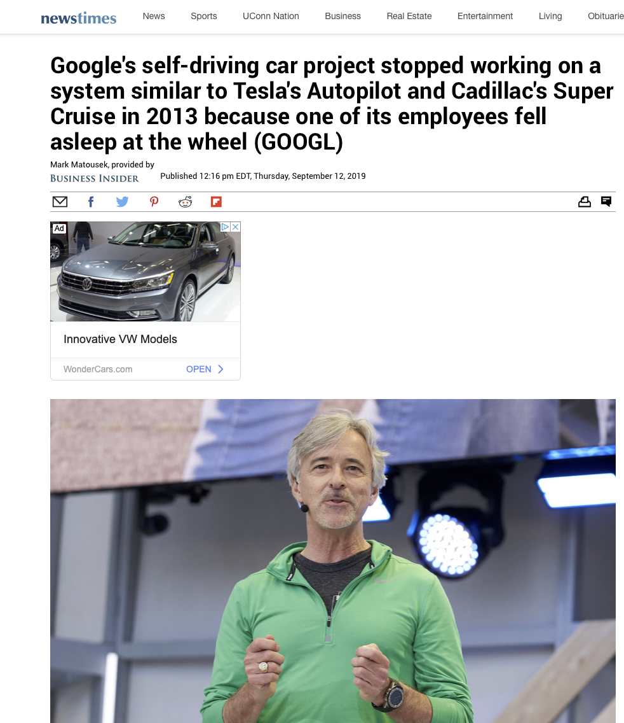
Yerkes–Dodson law
Notes:
https://en.wikipedia.org/wiki/Yerkes%E2%80%93Dodson_law#/media/File:HebbianYerkesDodson.svg
https://www.michiganautolaw.com/blog/2014/12/27/droopy-eyelid-detector/
https://duckduckgo.com/?q=overworked&t=ffsb&iar=images&iax=images&ia=images&iai=https%3A%2F%2Fc8.alamy.com%2Fcomp%2FABC687%2Foffice-environment-frustrated-overworked-office-worker-at-her-desk-ABC687.jpg

Slide 53
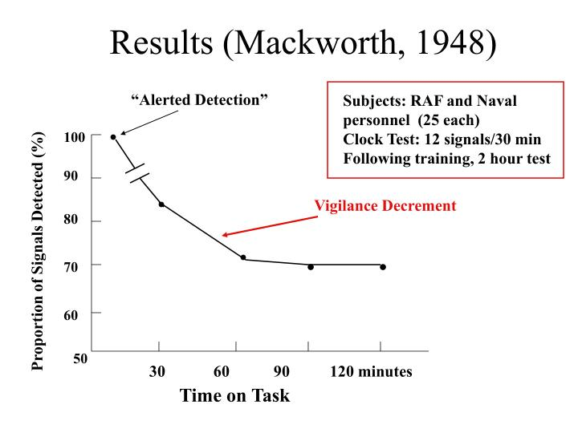
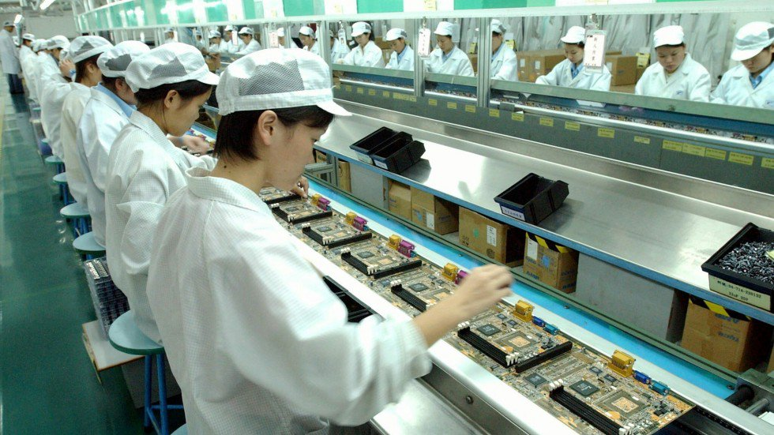
Vigilance Decrement
Notes:
https://image.slideserve.com/784124/results-mackworth-1948-n.jpg
https://www.scmp.com/news/china-insider/article/1343678/revealed-how-trade-unions-are-failing-shenzhens-factories

Slide 54
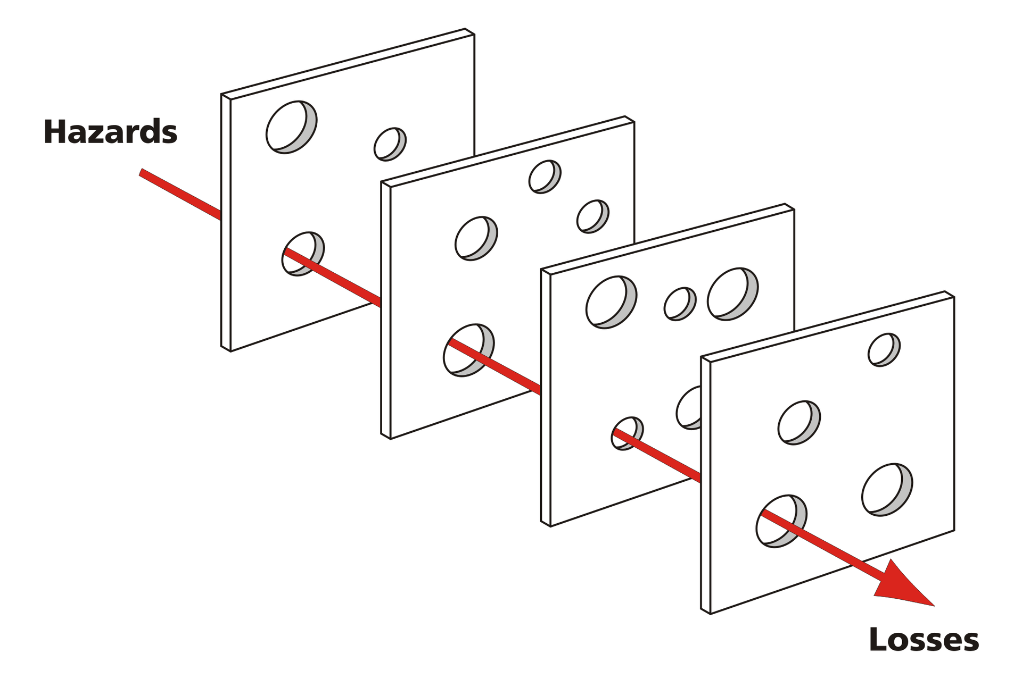
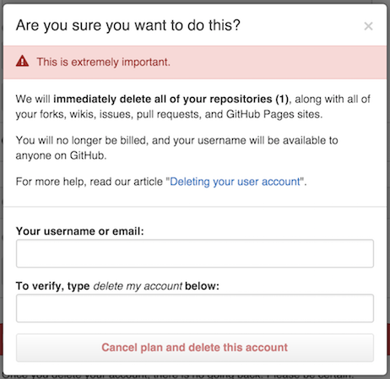

James Reason’s Swiss cheese model
Notes:
https://en.wikipedia.org/wiki/Swiss_cheese_model#/media/File:Swiss_cheese_model_of_accident_causation.png

Slide 55

Aesthetic Usability Effect
Masaaki Kurosu and Kaori Kashimura (1995) found ATM interfaces with high aesthetic appeal were also rated as performing better

Slide 56
Displaying Information

Slide 57
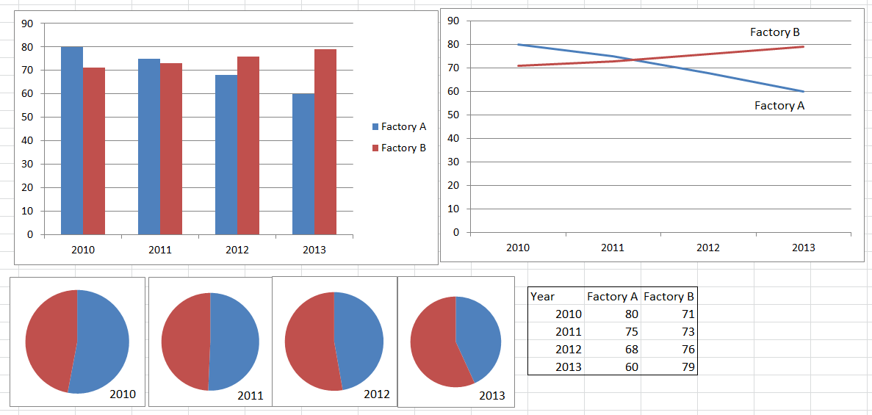
Data vs. Information

Slide 58
Task Taxonomies
Point reading
Observer estimates the value of a single graph element
What was Factory A’s Production in 2010?
Local comparison
The observer compares two values directly shown in the graph
Was Factory B’s Production greater in 2012 or 2011?

Slide 59
Global comparison
Compares quantities that must be derived from other quantities
Was Factory B’s total production in 2010 and 2011 less than Factory A’s Production in those years?
Synthesis judgment
The observer needs to consider all data points and make a general, integrative judgment
What will Factory A’s production likely be in 2014? Is Factory A’s production increasing or decreasing?

Slide 60
How
Use physical dimensions judged without bias. Avoid illusions that might bias how the graphs are interpreted
Using length is better than area or volume. Why?
Consider the task
Graphical form should support task demands
Minimize the number of mental operations
Graph the relevant data, organize it in a logical fashion

Slide 61
Keep the data-ink ratio high (Tufte, 1983)
Actual data represented relative to the amount of ink it takes to represent it
Code Multiple graphs consistently
Represent conditions consistently, use consistent units, maintain consistent axis ranges when possible

Slide 62
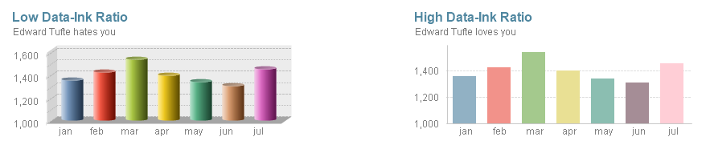
Data Ink Data to Ink Ratio = Total Ink
https://hub.packtpub.com/dashboard-design-best-practices/
Notes:
https://hub.packtpub.com/dashboard-design-best-practices/

Slide 63
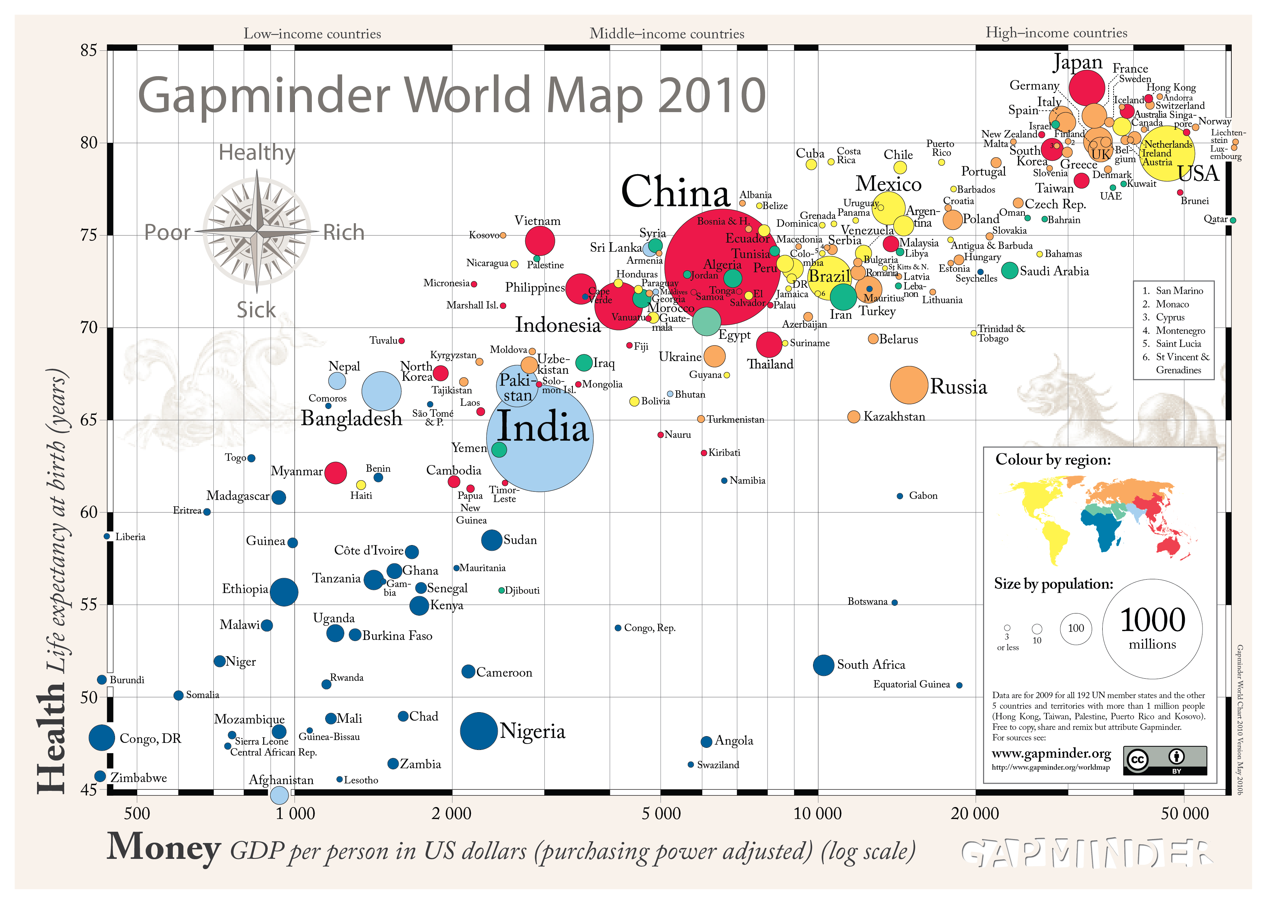

Slide 64
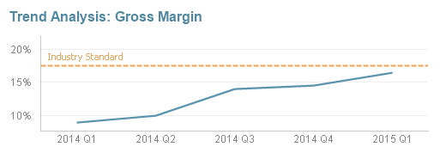
Tip: Provide Context to Data
Notes:
https://hub.packtpub.com/dashboard-design-best-practices/

Slide 65
Tip: Redundant Coding
Redundant
Neutral
Conflicting
Red
Blue
Black
Green
Purple
Yellow
XXXX
XXXX
XXXX
XXXX
XXXX
XXXX
Blue
Purple
Green
Red
Yellow
Black

Slide 66




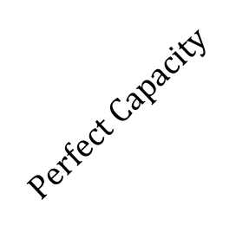





Information Capacity for Absolute Judgements
$$Noise$$
$$Perfect Capacity$$
$$H_{T}$$
$$H_{S}$$
$$H_{R}$$
$$H_{T}$$
$$H_{loss}$$
$$Human$$
$$H_{T}=H_{S}+H_{R}{−H}_{SR}$$
$$H_{S}$$

Slide 67
Information Capacity
Measuring Capacity
Pick a stimulus continuum
e.g. tone pitch
Slowly increase the number
of the presented stimuli
Measure information
transmission
Most continuums have a channel capacity is usually 2-3 bits
Saltiness: < 2 bits
Visual position on a line: 3.4 bits

Slide 68

Applications of Object-Based Processing
Conformal display- alignment between the object displayed and the outside scene

Slide 69
Pictorial realism
The principle of pictorial realism (PPR)
If a variable’s physical representation is analog, then its display representation should be analog
e.g. Altimeter
Task requirements also play a role
What do users need to do?
Reading time vs. reading time span (Miller and Penningroth, 1997)
Perceiving magnitude of a variable vs. perceiving rate of change (Proctor & Van Zandt, 2008l Schwartz & Howell, 1985)

Slide 70
Compatibility of Display Movement
Principle of the Moving Part (PMP)
Movement of an indicator should be compatible with operator’s mental model
Mercury thermometer
Sometimes PPR and PMP operate in opposition and cannot both be met

Slide 71
50,000 --
40,000 --
30,000 --
20,000 --
10,000 --
0 --
600
500
400
300
200
100
100
200
300
400
500
600
Moving Pointer Indicator
Moving Scale Indicators

Slide 72


Slide 73


Process Control / Critical Infrastructure
Notes:
https://philadelphiaweather.blogspot.com/2006/09/tropical-storm-florence.html
https://www.geek.com/science/fukushima-radiation-has-reached-california-but-its-really-nothing-to-worry-about-1609326/

Slide 74


Not a high performance HMI

Slide 75
High Performance HMIs
Do not resemble P&IDs, do resemble the process
Encapsulate operator mental models but not designed by operators
Task Analysis
Commission and Training
Are hierarchical
Process Overview Displays
Process Control Displays
Process Detail Displays
Process Support and Diagnostics Displays
Consider Abnormal Situation Response

Slide 76


Slide 77
Good Alarm Management
Categorizes alarms based on priority (required response time)
Avoids false alarms (nuisance alarms)
Aim for < 150 / day, 6 per hour, 1 per 10 minute period
Has consistent annunciation representation by priority (color, sound)

Slide 78
Evaluation
Nuclear
Human-System Interface Design Review Guidelines (NUREG-0700, Revision 2)
Human Factors Engineering Program Review Model (NUREG-0711, Revision 3)
Military
Mil-std-1472 G Design Criteria Human Engineering
ISO
ISO/TR 16982:2002 Ergonomics of human-system interaction -- Usability methods supporting human-centred design

